Slide 1

VULNERABILITY ASSESSMENT AND PENETRATION TESTING
SUBMITTED BY
GROUP NO:-03
KASHISH SHAH:-21082291026
JAY SONI:-21082291028
B.SC.IT(CYBER SECURITY) SEMESTER-V

Slide 2
Project Profile
Project Title | VAPT
Objective | To perform Internal & External vulnerability assessment
OS | Windows , Linux
Tools | Nmap, Burp Suite, SQLmap,PwnXSS
Internal Guide | Prof.Helly Patel

Slide 3
Context
Tools & Technology
Introduction
Objective
1
Introduction
Introduction of Vulnerability Assessment and Penetration
Objective
Objective of our project.
2
Tool & Technology
Description of tools & technology used in our project.
3

Slide 4
1
Vulnerability Assessment and Penetration Testing (VAPT) is a security testing method used by organization to test their applications and IT networks.
2
A Vulnerability Assessment (or vulnerability scan) is an information security process used to identify weaknesses or vulnerabilities in a computer system or network.
Introduction
3
A Penetration Testing (or pen test) is an authorized simulated attack on a computer system performed to evaluate the system’s security.
4
Vulnerability scanning is performed within the security parameter and Penetration testing is performed outside of the security parameter.

Slide 5















Objective
We are doing Vulnerability Assessment and Penetration Testing on websites and android applications..
Using Penetration testing process we are discovering possible vulnerabilities within a website.
The goal of vulnerability scanning and penetration testing is to identify potential weaknesses and attack a website.
Our goal is to better understand an application's
behavior and identify vulnerabilities
Information Analysis and Planning
Scope Finding
Information Gathering
Vulnerability Detection

Slide 6








Tools & Technology
Nmap 7.94
It allows a large number of scanning techniques, such as UDP, TCP connect (), TCP SYN (half-open), and FTP.
Burp Suite Professional/Community 2023.9.4
It is an integrated platform and graphical tool for performing security testing of web applications.
Sqlmap 1.6.11
It is an open source penetration testing tool that is use to do process of detecting and exploiting SQL injection.
PwnXss v0.5
For XSS Attack. It is a powerful XSS scanning and parameter analysis tool.

Slide 7
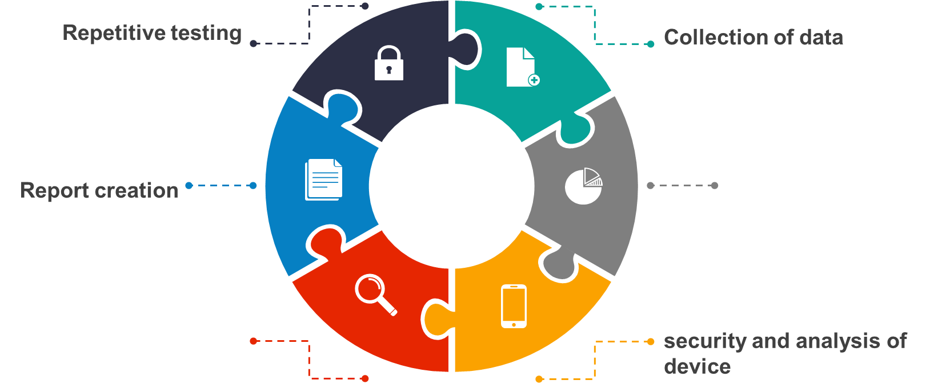
Vulnerability Assessment
Identification of possible network threats
scanning for identified
vulnerability

Slide 8






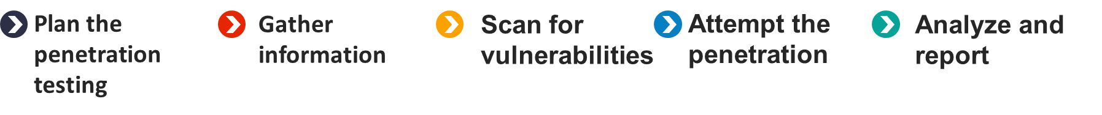
Penetration Testing

Slide 9
Hardware and Software Requirement
Hardware Requirement
Processor | 1.6 GHz
RAM | 8 GB
Free Hard Disk Space | 40 GB
Software Requirement
Operating System | Linux & Windows
Tools | Nmap,Burp-suite, SQLmap,PwnXSS

Slide 10


Platform
Windows – VirtualBox
We have used some websites for vulnerability assessment.
Kali Linux is used for advanced
Penetration Testing and Security Auditing
Kali Linux – VirtualBox
Nmap
Sqlmap
hping3
.

Slide 11
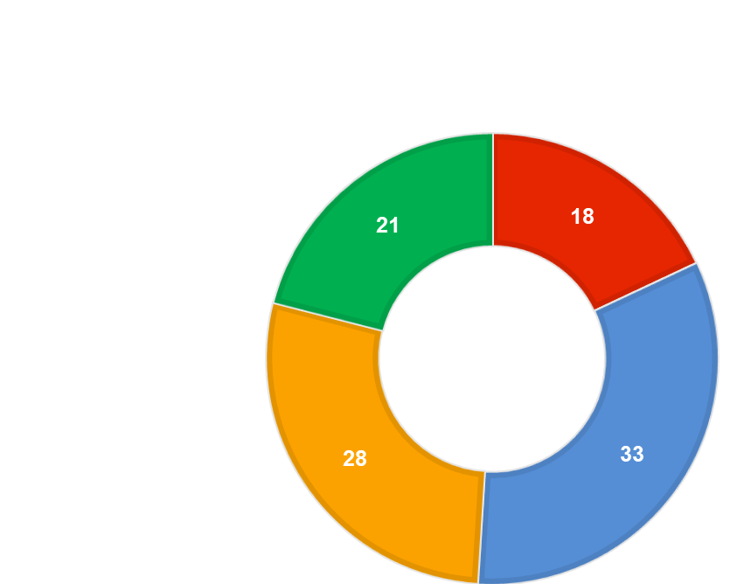




WORKFLOW
Critical
High
Medium
Low
Server Version Disclosure
HTML Injection
SQL Injection
Clear Text Password Submission
No Rate Password Limit
Cross site scripting (XSS)
OTP bypass
OTP Email bypass
Directory Traversal
File Upload

Slide 12
No. | Vulnerability Name | Severity
1. | HTML Injection | Low
2. | Server Version Disclosure | Low
3. | Directory Traversal | Medium
4. | File Upload | Medium
5. | OTP Bypass | High
6. | Clear Text Password Submission | High
7. | Email Bypass | High
8. | Cross Site Scripting (XSS) | High
9. | No Rate Password Limit | High
10 | SQL Injection | Critical

Slide 13


Slide 14

1
HTML Injection
Website: https://www.smtmax.com/dden.com/

Slide 15




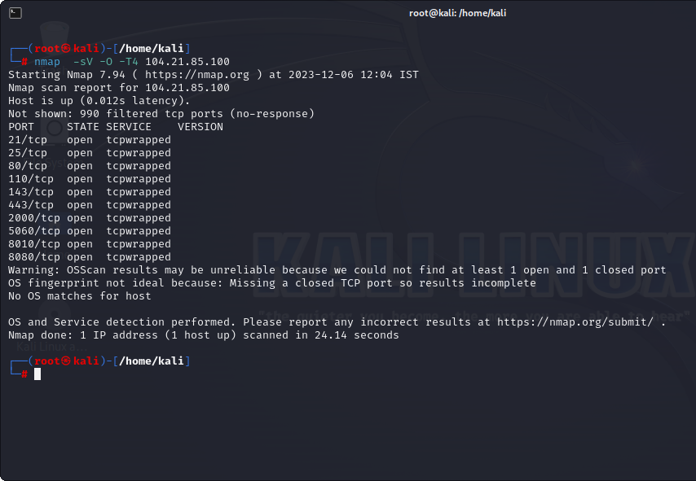


Target Site
https://www.smtmax.com/
Vulnerability
HTML Injection
Severity
Low (https://bugcrowd.com/vulnerability-rating-taxonomy)
Impact
An attacker to inject HTML code into web pages that are viewed by other users and allow an attacker to modify the page.
Tools
Nmap

Slide 16
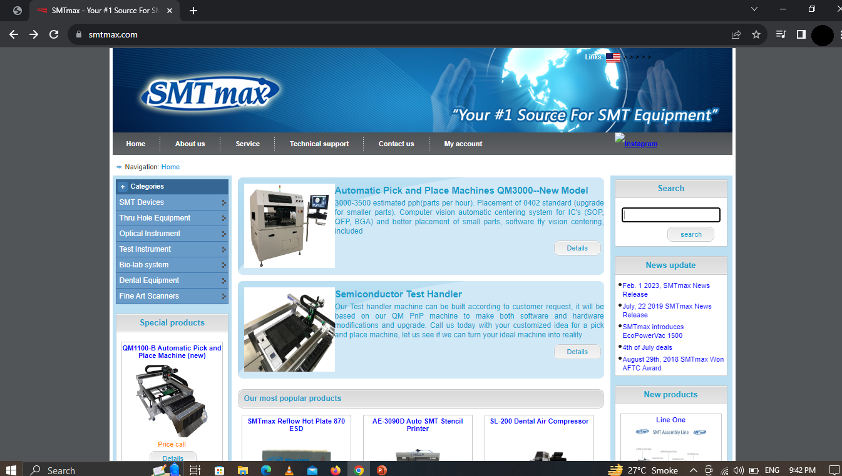
Step 1 :- Visit this site

Slide 17
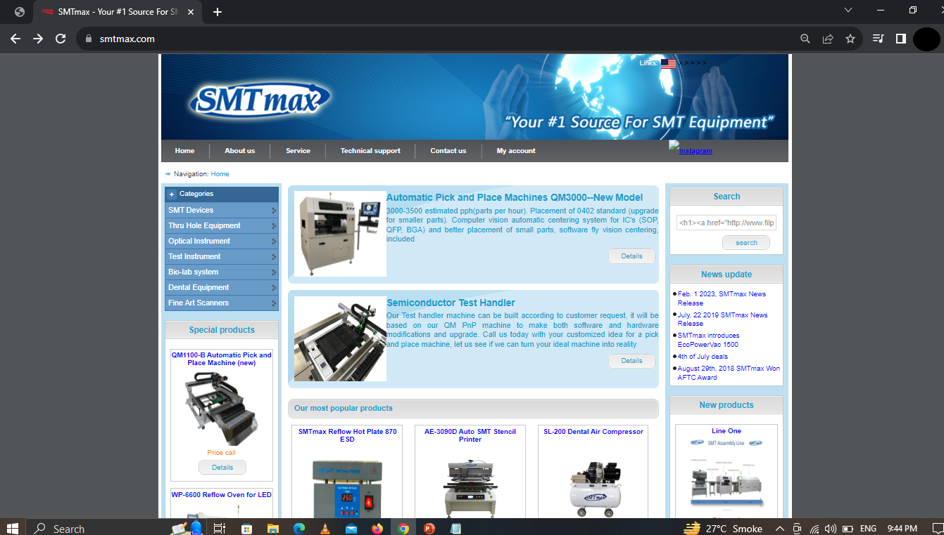
Step 2 :- In this search option to write the html code:
<h1><a href=”https://www.flipkart.com/”>click me</a></h1>

Slide 18
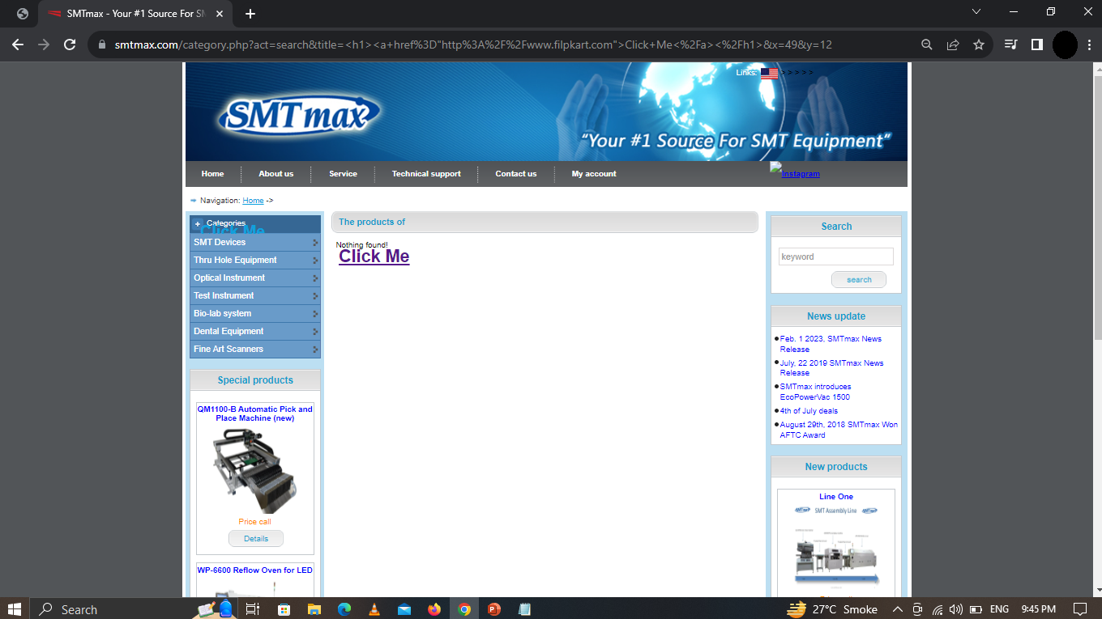
Step 3 :-Then Enter and we can click the “CLICK ME”.

Slide 19
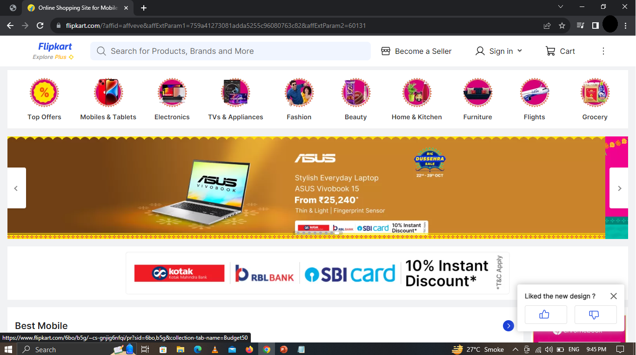
Step 4 :- As a result,we can redirect to the flipkart.com

Slide 20
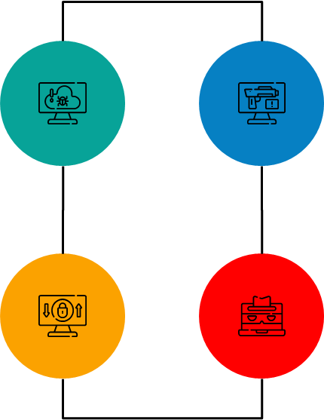
HTML Injection Prevention
This type of Html injection attack occurs when the input and output are not properly validated. So, give proper validation.
Use Post method mainly to hide the URL and the vulnerable parameter from attacker.
Every input should be checked if it contains any script code or any HTML code. Usually, it is checked, if the code contains any special script or HTML brackets – <script></script>, <html></html>.
The main rule to prevent HTML attacks is appropriate data validation.

Slide 21

2
Server Version Disclosure
Website: https://www.iphbooks.com

Slide 22

Target site
https://www.iphbooks.com/
Vulnerability
Server version disclosure
Severity
Low (https://bugcrowd.com/vulnerability-rating-taxonomy)
Impact
An attacker can use the disclosed the information to harvest specific vulnerability for the version identified.
Tools
Burp suite

Slide 23

Step 1 :- Visit this site

Slide 24
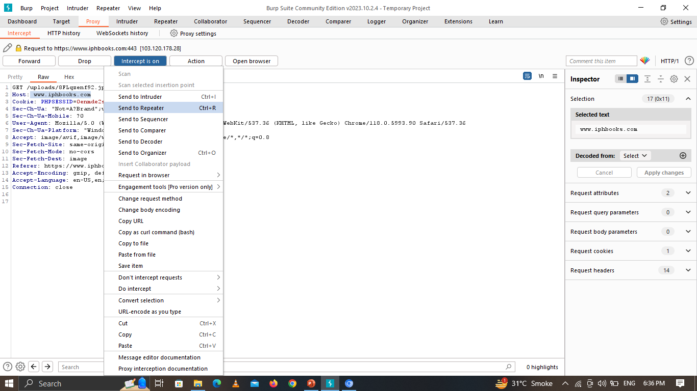
Step 2:- Here we have capture the request and sent it to Repeater

Slide 25
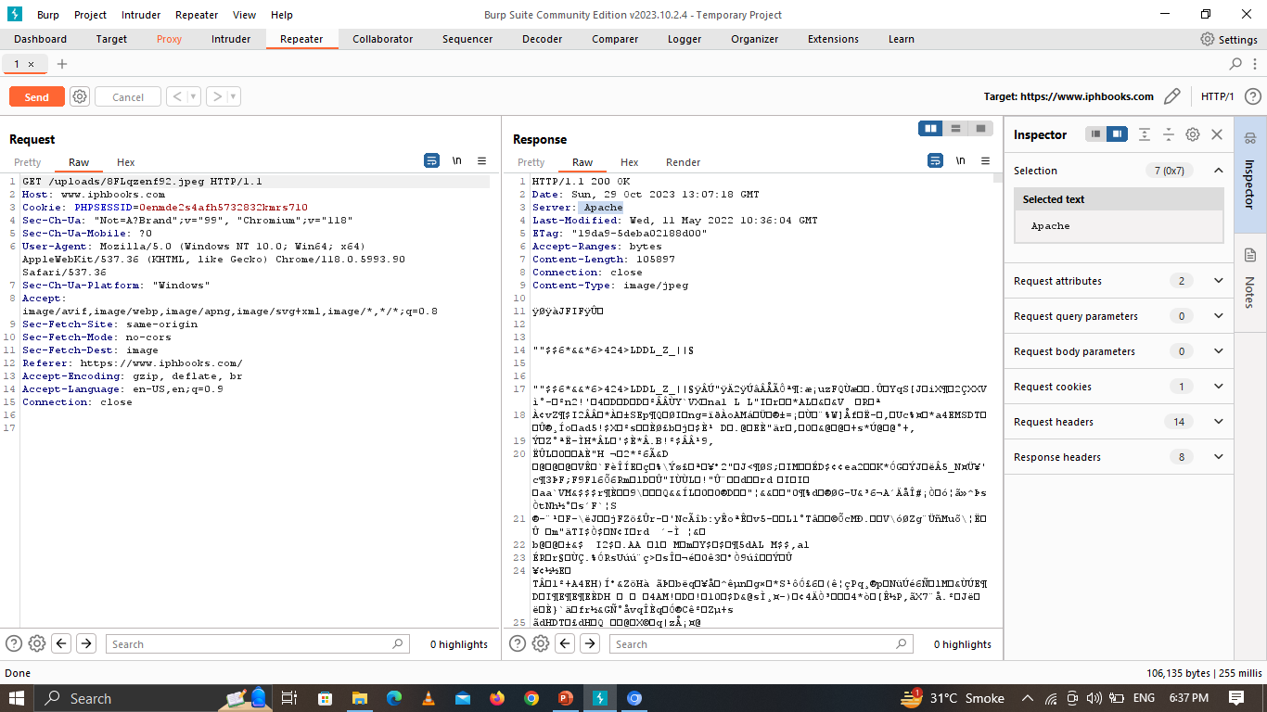
Step 3 :- Now in repeater click on send and then we can see the server version of the site.

Slide 26
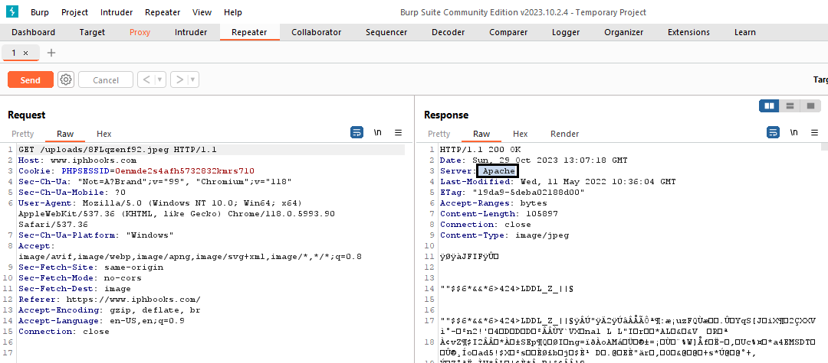
Step 4 :- As a result,we can see the server apache version of the site.

Slide 27






Server Version Disclosure Prevention
Properly setting authentication cookies with Same Site Strict, unless they explicitly need None
Simply need to reconfigure the web server and, if necessary, restart it.
Resolve misconfigurations and uninstall high-risk software.

Slide 28

3
Directory Traversal
Website: www.mim.ac.mw

Slide 29
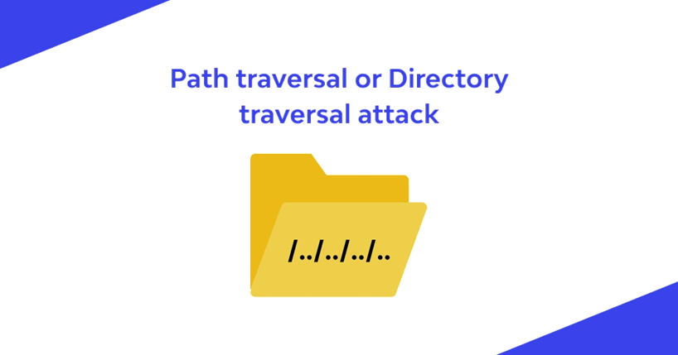
Target site
www.mim.ac.mw
Vulnerability
Directory Traversal
Severity
Medium (https://bugcrowd.com/vulnerability-rating-taxonomy)
Impact
Access to sensitive information.
Tools
Nmap

Slide 30
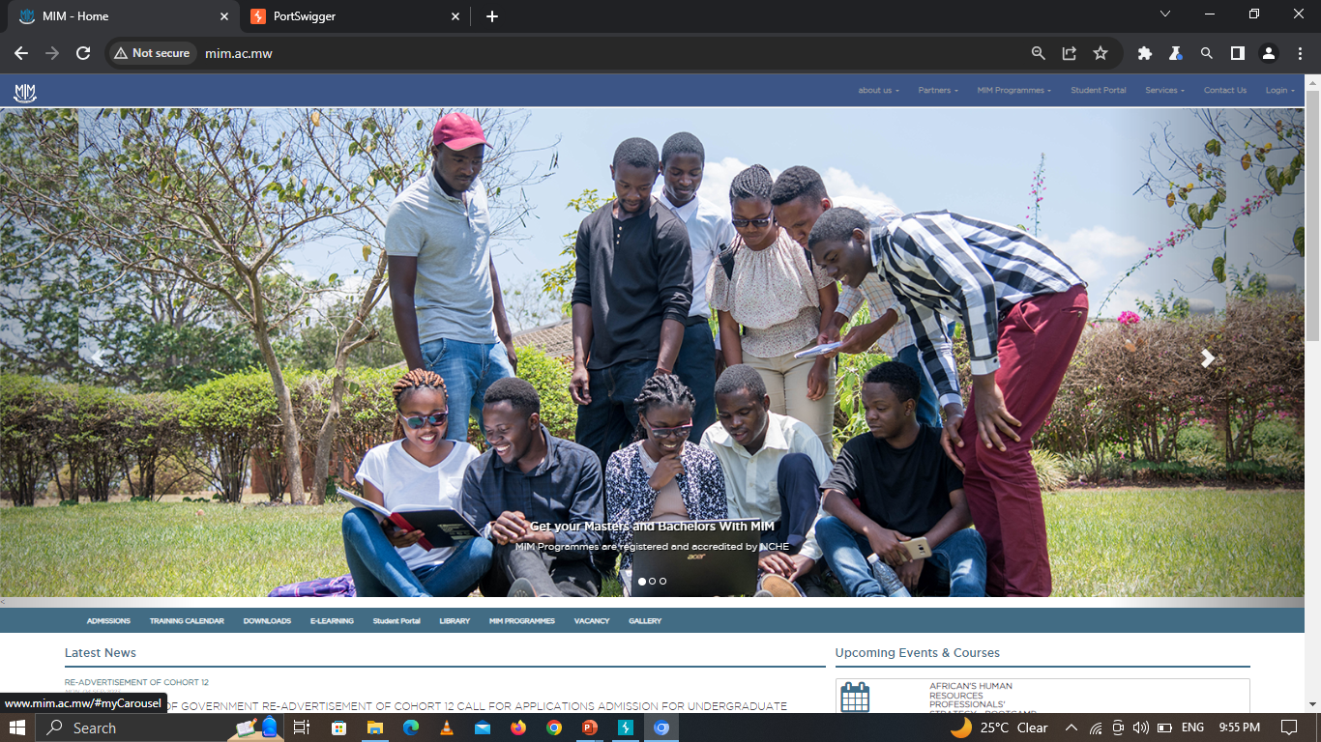
Step 1 :- Visit this Website

Slide 31
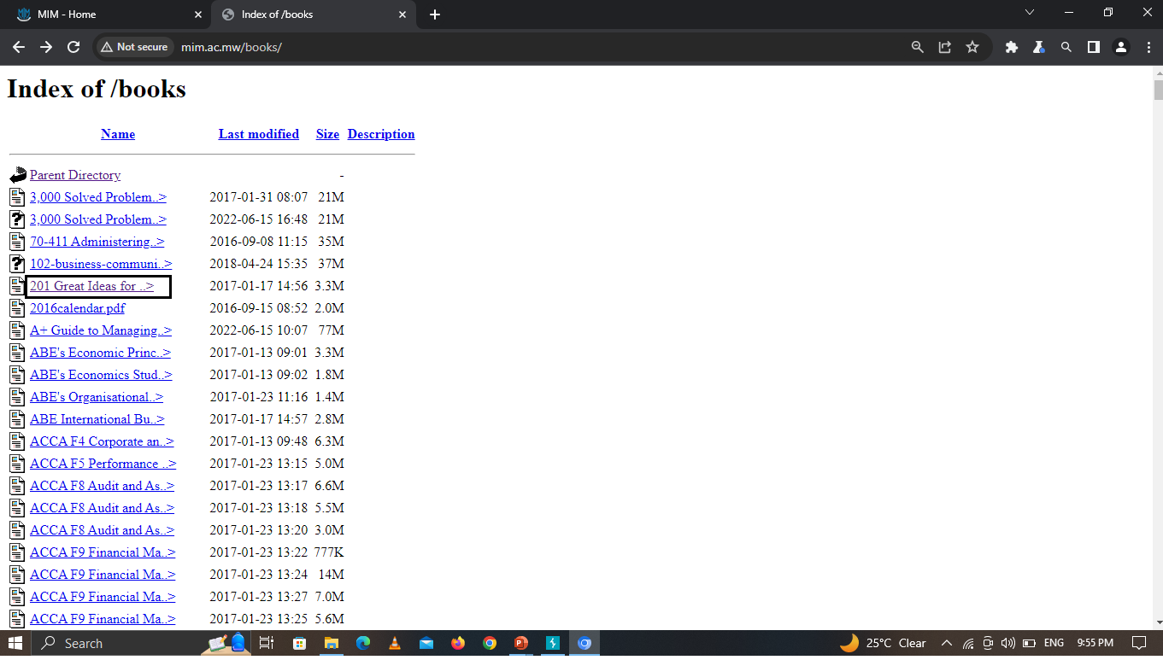
Step 2 :- Go to the eBooks Directory and click on the Books

Slide 32

Step 3 :- As a result, we can see the pdf and Attackers can access any directory of the website.

Slide 33
Directory Traversal Prevention
To prevent directory traversal in your web server, always keep your web server and operating system.
Avoid passing user-supplied input to file system APIs altogether.
The website should validate user input before processing it to prevent directory traversal attack.
Update your web server and operating system to the latest versions available.

Slide 34

4
File Upload
Website :-www.biramangolcollege.edu.in

Slide 35

Target Site
https://biramangolcollege.edu.in/
Vulnerability
File Upload
Severity
Medium (https://bugcrowd.com/vulnerability-rating-taxonomy)
Impact
Being easy to execute and potentially exploited for various malicious activities, a file upload vulnerability is a common target of hackers. Using this file upload vulnerability attacker can perform the Phishing attacks, Remote code execution etc.
Tools
Nmap

Slide 36
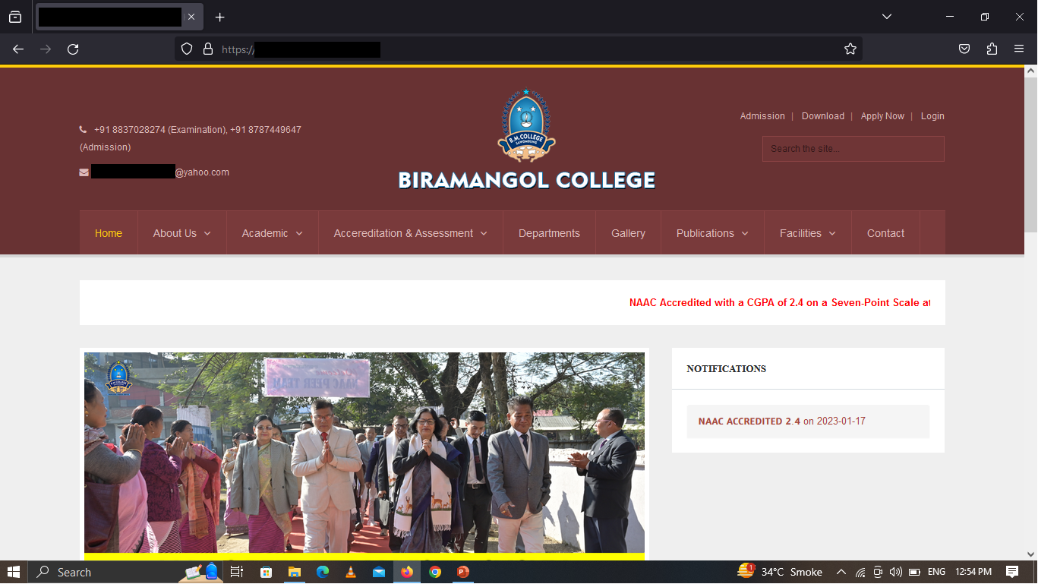
Step 1 :- Visit this site

Slide 37
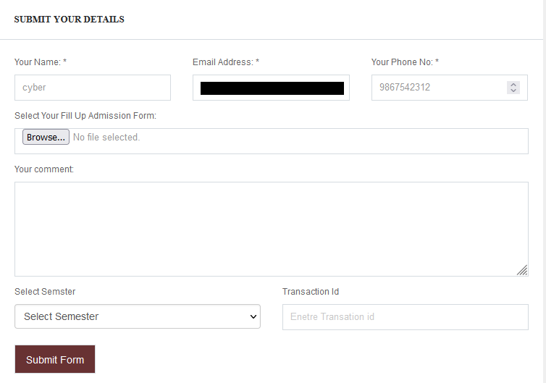
Step 2:- And go to the Registration page.

Slide 38
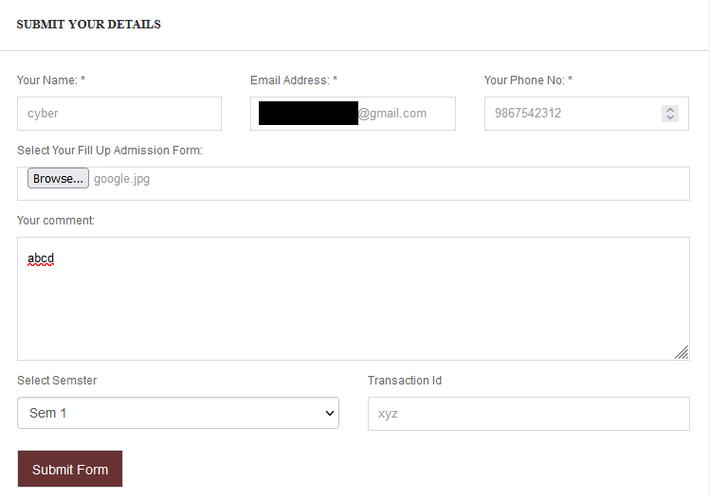
Step 3 :- Fill up all the details like name,email,phone no,comment,semester,
Transaction id. After click the choose file and select the php file.

Slide 39
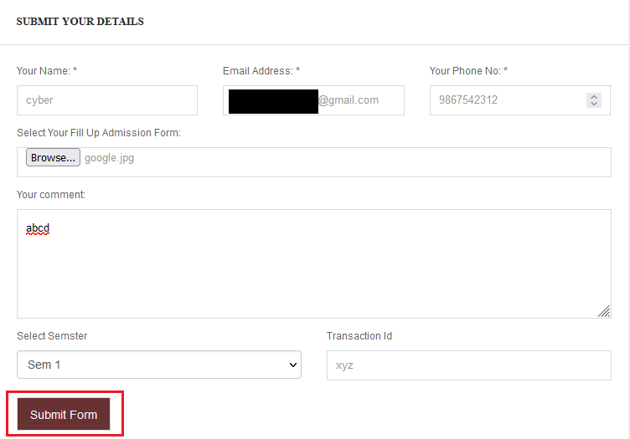
Step 4 :- In this php file we can write a malicious script and after submit form this php file store on the server. It is a very harmful.
Step 5 :- We can select file after click the submit form button and this form successfully register.

Slide 40
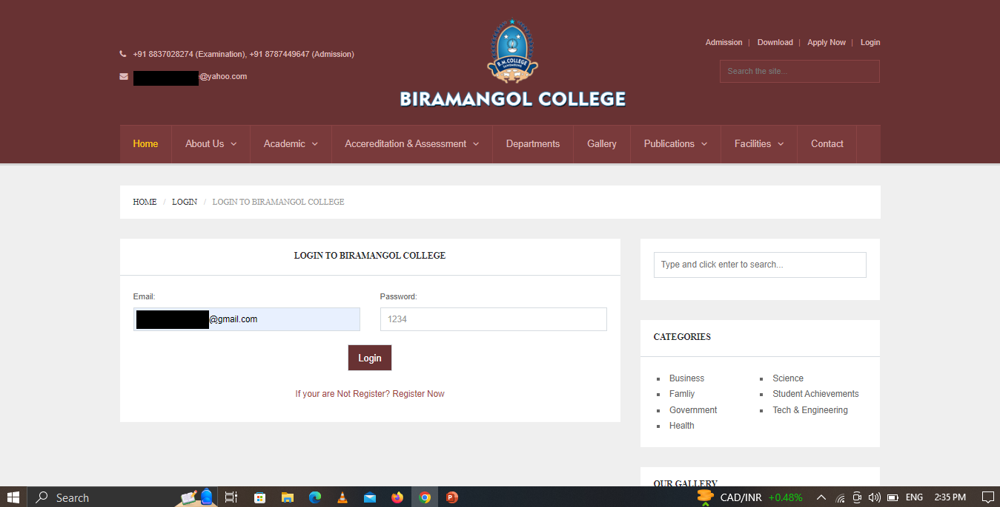
Step 6 :- As a result,using email address and password we can login successfully

Slide 41
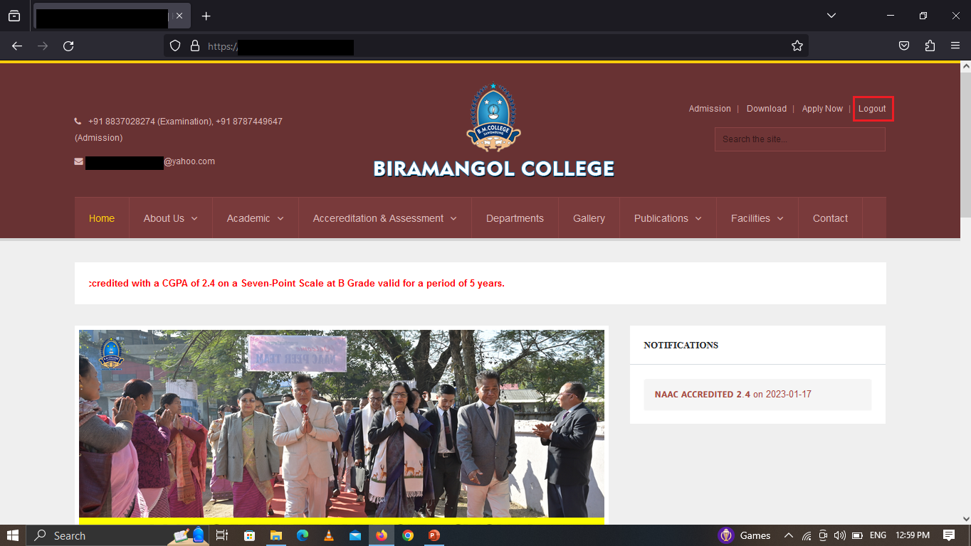

Slide 42



File Upload Prevention
Only allow specific file types
Verify file types.
File size restrictions.

Slide 43

5
OTP Bypass
Website: www.thesouledstore.com

Slide 44
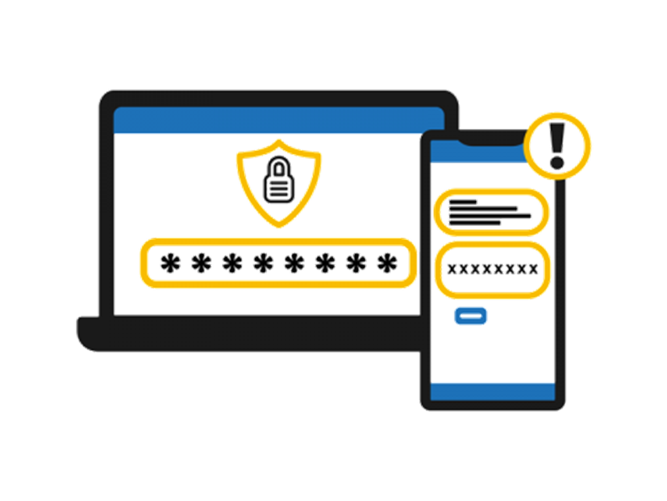
Target Site
www.thesouledstore.com
Vulnerability
OTP Bypass
Severity
High (https://bugcrowd.com/vulnerability-rating-taxonomy)
Impact
Stealing someone's identity to access their accounts, such as bank accounts or credit cards. This enables the attacker to purchase goods using these details
Tools
Burp Suite

Slide 45
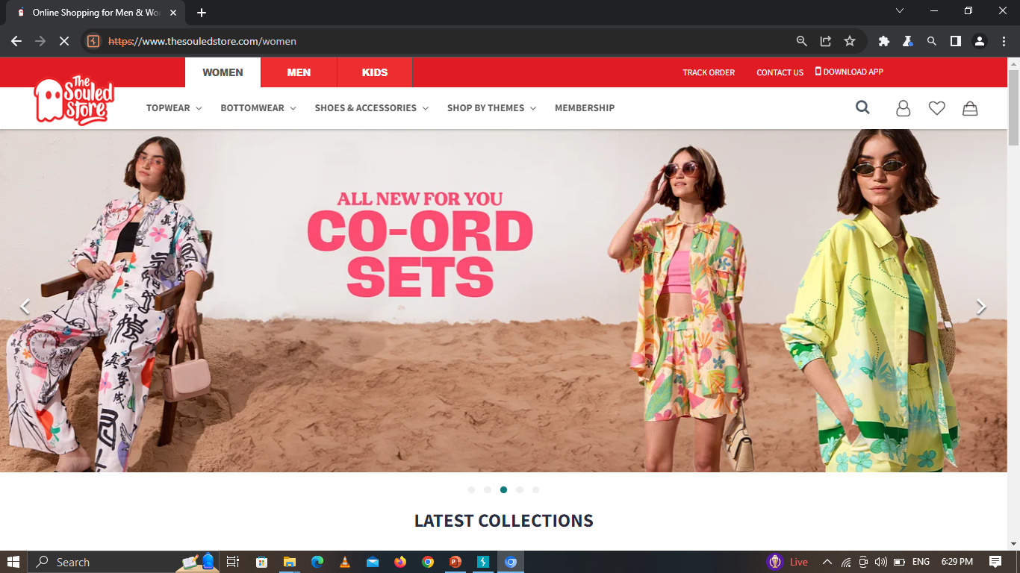
Step 1 :- Visit this site

Slide 46
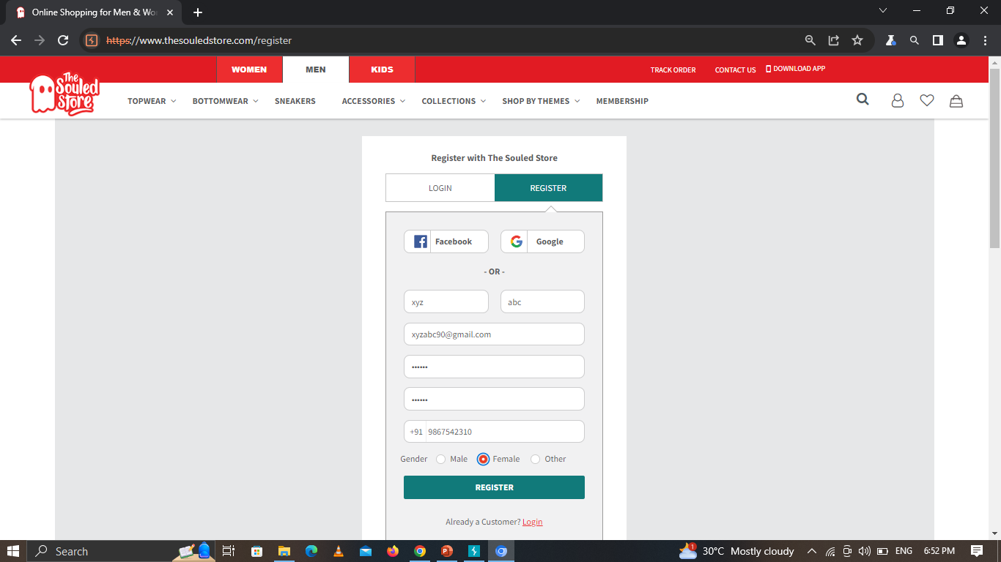
Step 2 :- Click on Register Page and Fill the detail and Register

Slide 47
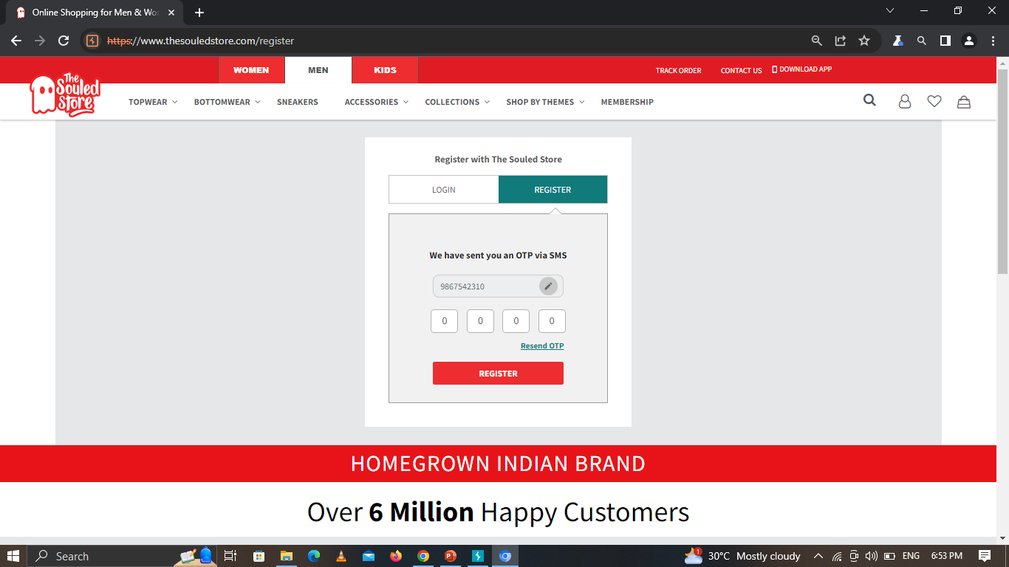
Step 3 :- Enter any wrong OTP and click register

Slide 48
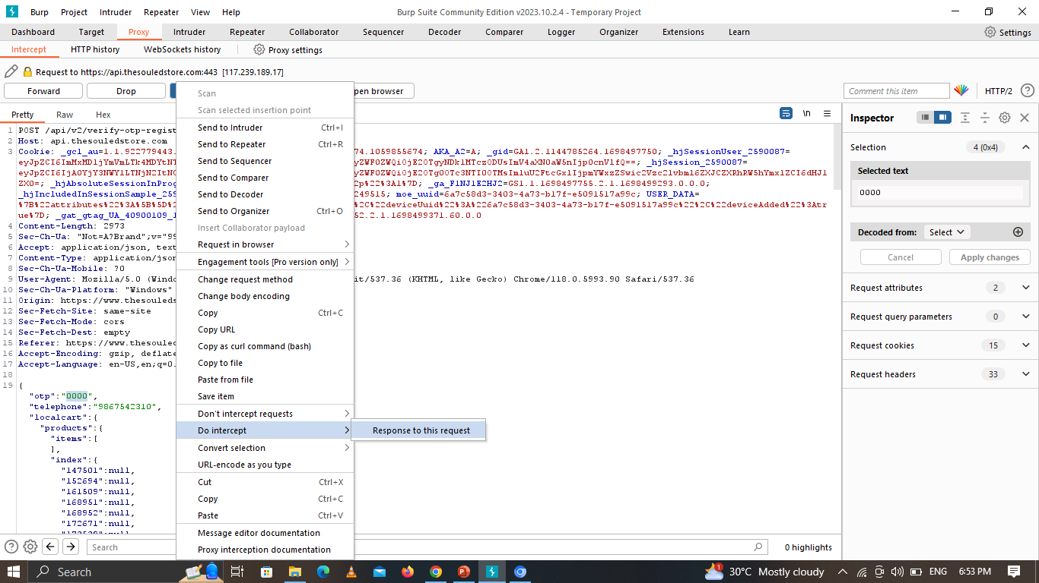
Step 4 :- After click on register,capture request in burp suite and send response to request.

Slide 49
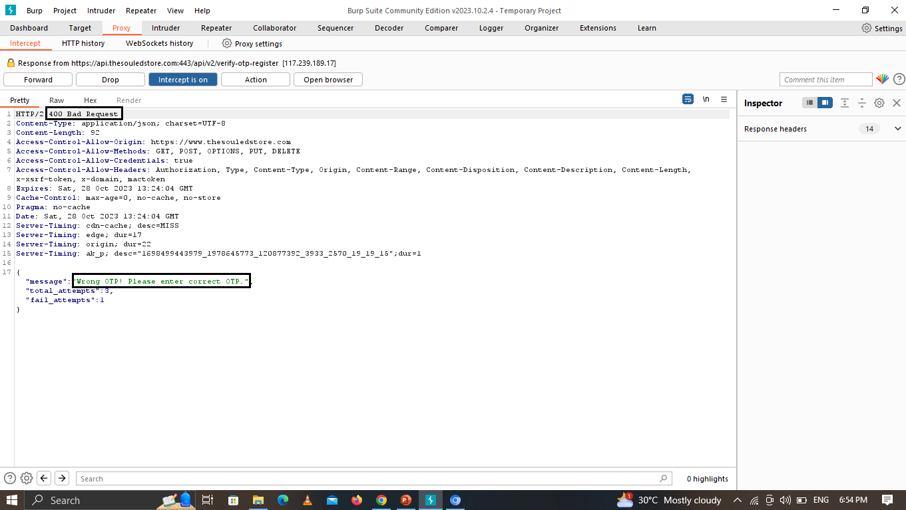
Step 5 :- In this repeater we can see the request and right OTP response.
After click the Forward and We get this request. We can modify this request.

Slide 50
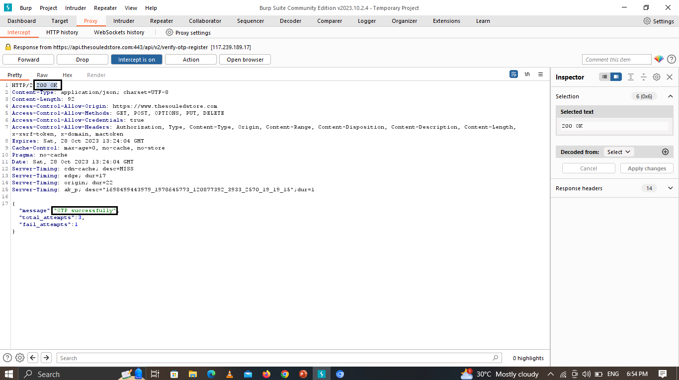
Step 6 :- Change the code 400 bad request to 200 ok.
After click the Forward.

Slide 51
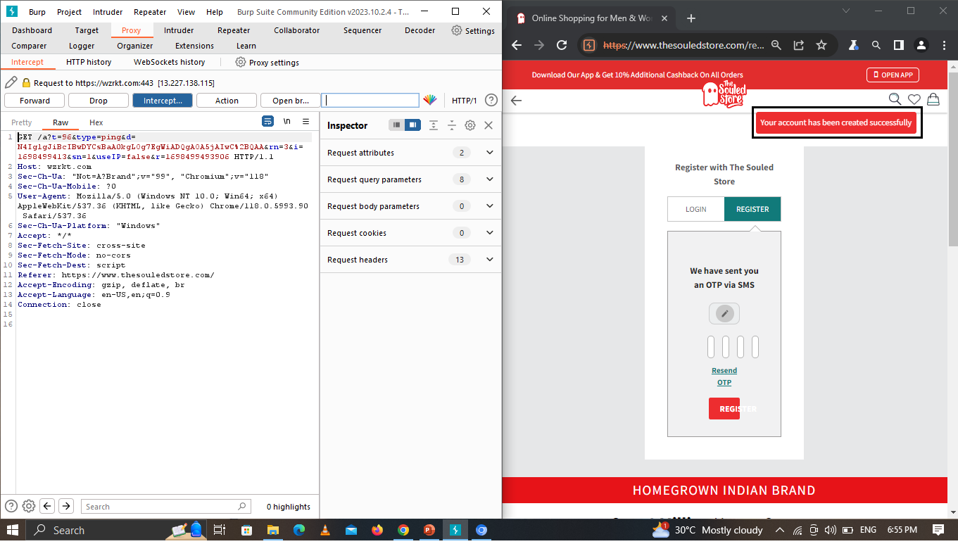
Step 7 :- As a result,this account is created successfully.

Slide 52
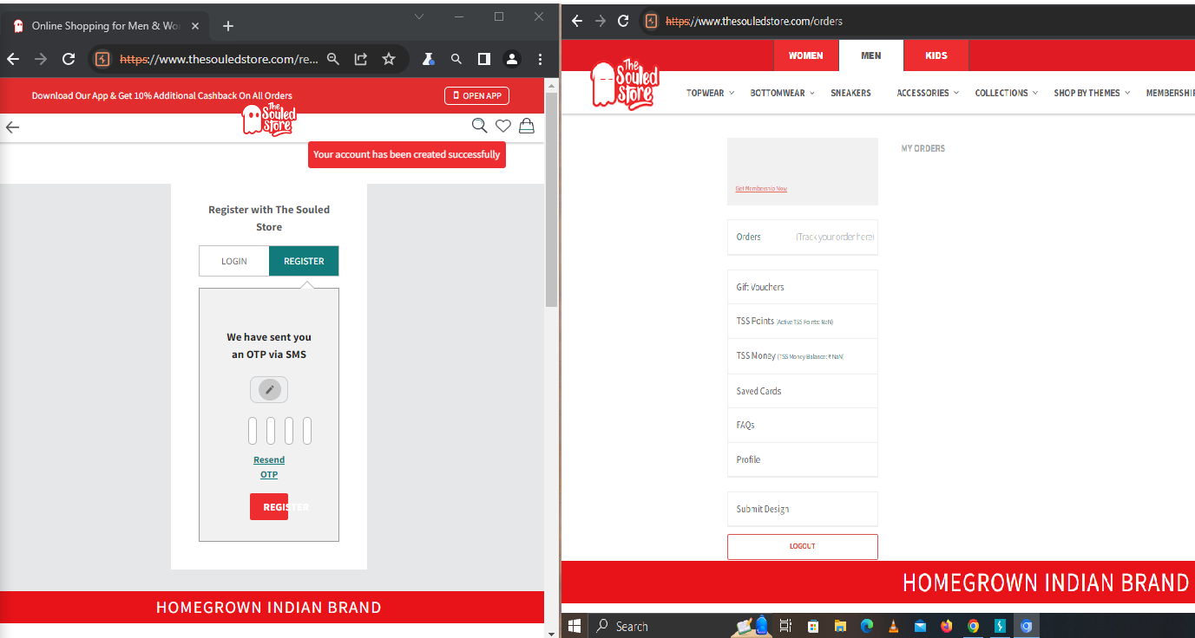
Step 8 :-This account has been created successfully.

Slide 53












OTP Bypass Prevention
Use CAPTCHA
Use strong password
Limit Logins to a Specified IP Address
Use 2-Factor Authentication
Monitor Your Server Logs
Account Lockouts After Failed Attempt

Slide 54

6
Clear Text Password Submission
Website: https://www.iphbooks.com/

Slide 55

Target Site
https://www.iphbooks.com/
Vulnerability
Clear Text Password Submission
Severity
High (https://bugcrowd.com/vulnerability-rating-taxonomy)
Impact
Some applications transmit passwords over unencrypted connections, making them vulnerable to interception.
Tools
Burp suite

Slide 56
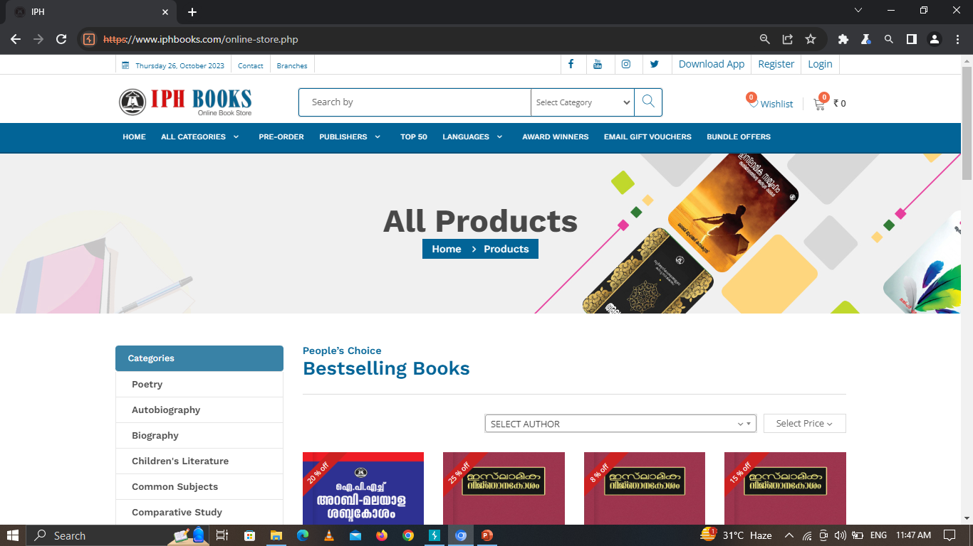
Step 1 :- Visit this site

Slide 57
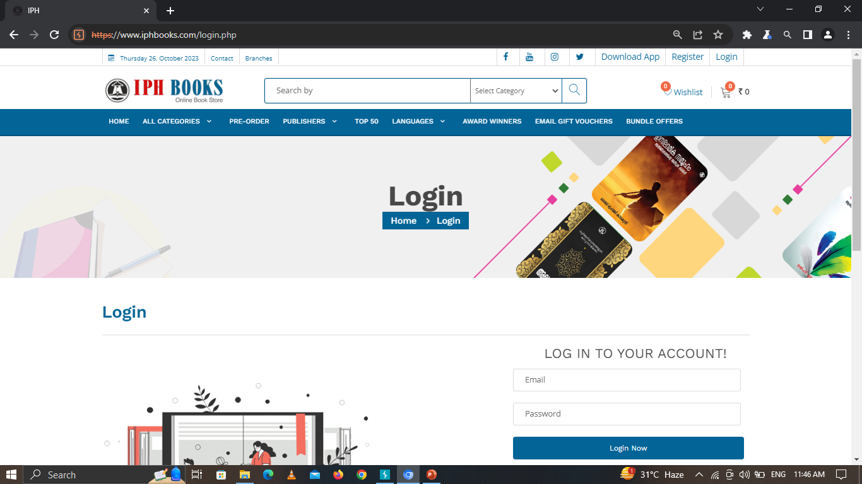
Step 2 :- After that go to the login page.

Slide 58
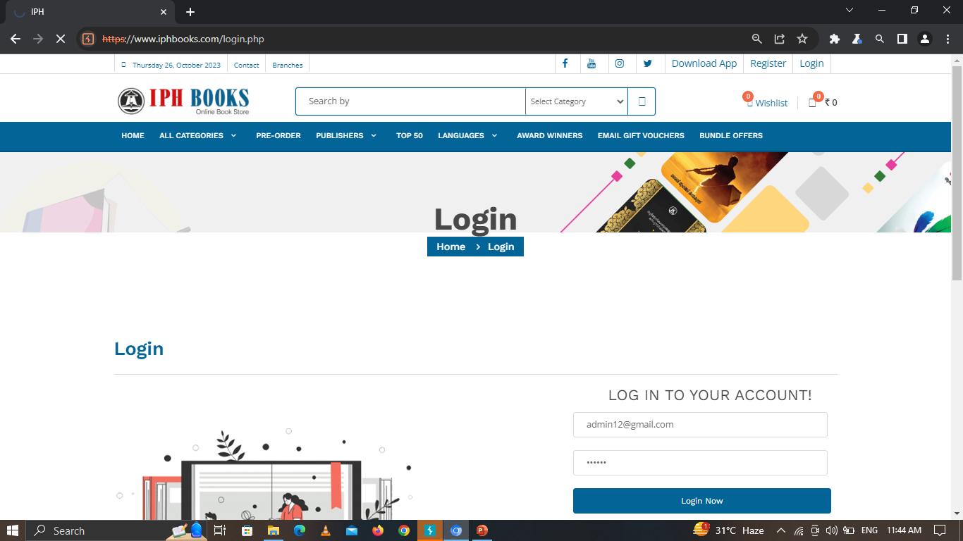
Step 3 :- Here we have enter the username and password and submit it.

Slide 59
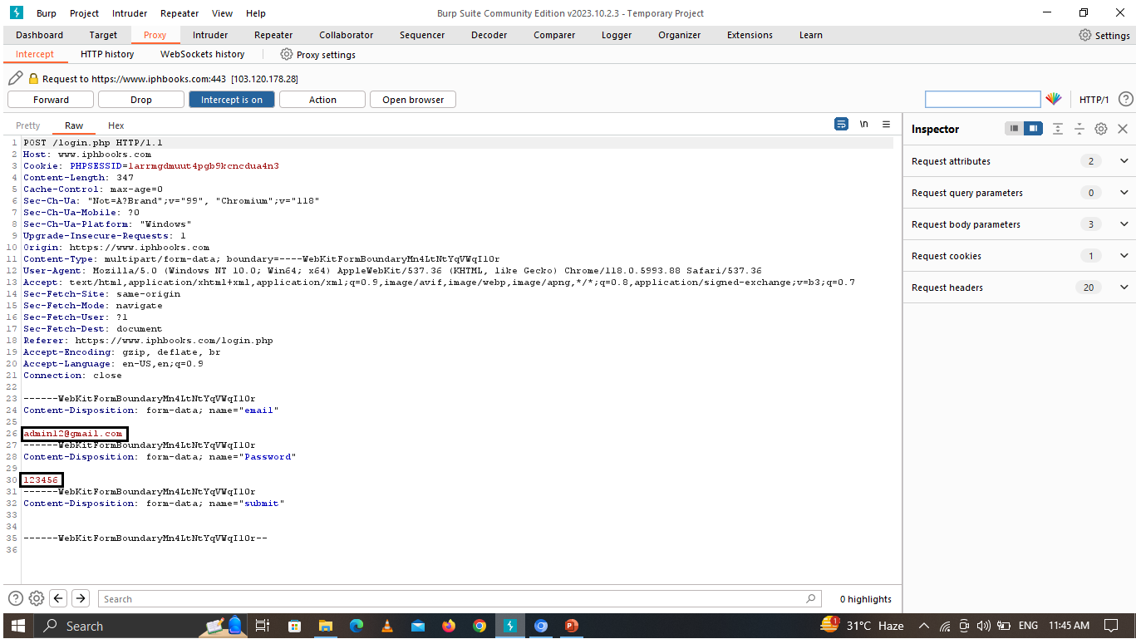
Step 4 :- As a result, Now using burp suite we can see the username and password clearly.

Slide 60


Clear Text Password Submission Prevention
Password must be in an encypted formate.
Password must include signs and symbols to make it strong.

Slide 61
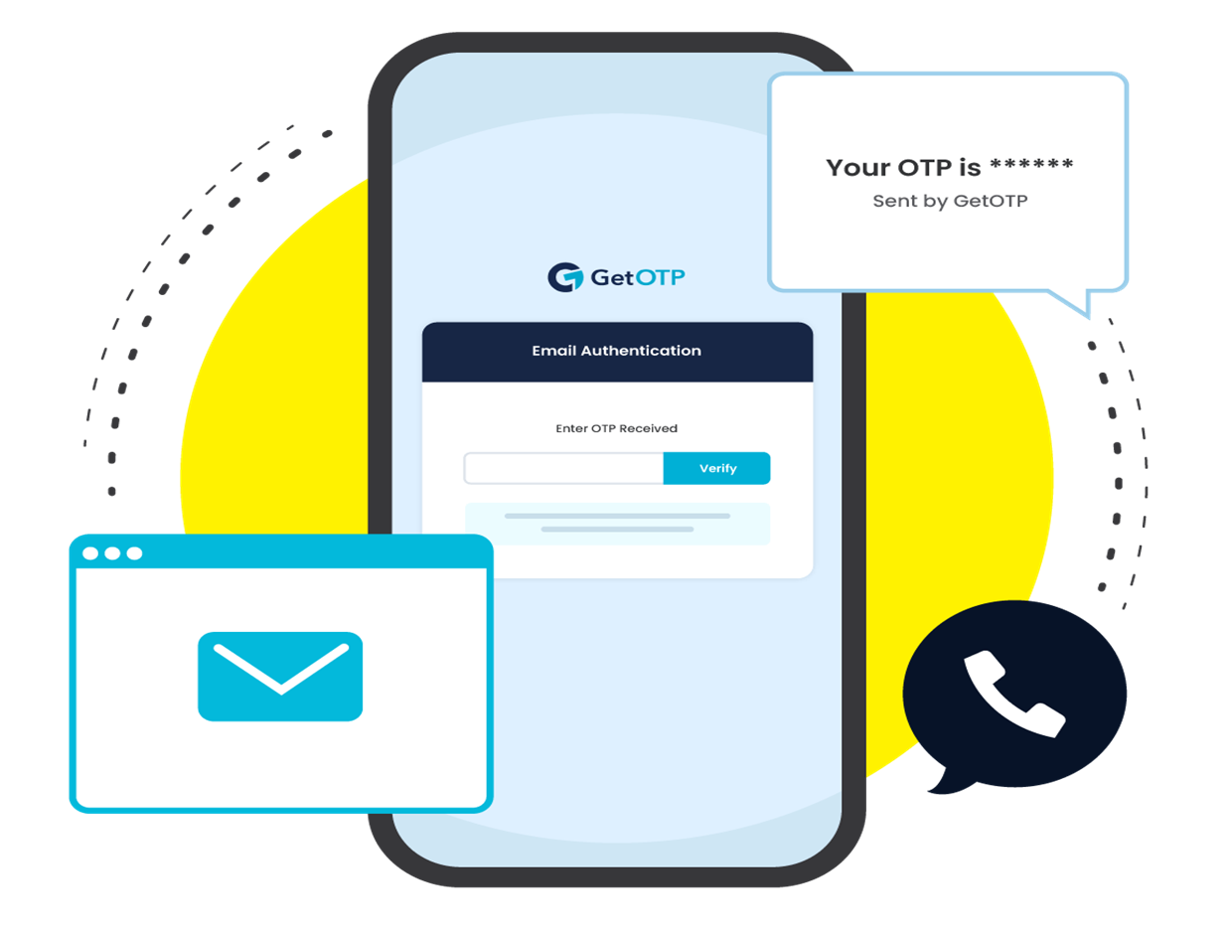
7
Email Bypass
Website: https://app.upchieve.org/

Slide 62

Target Site
https://app.upchieve.org/
Vulnerability
Email Bypass
Severity
High (https://bugcrowd.com/vulnerability-rating-taxonomy)
Impact
Malicious attacks can gain access to sensitive information and leading to data breaches and potential legal consequences.
Tools
Burp Suite

Slide 63
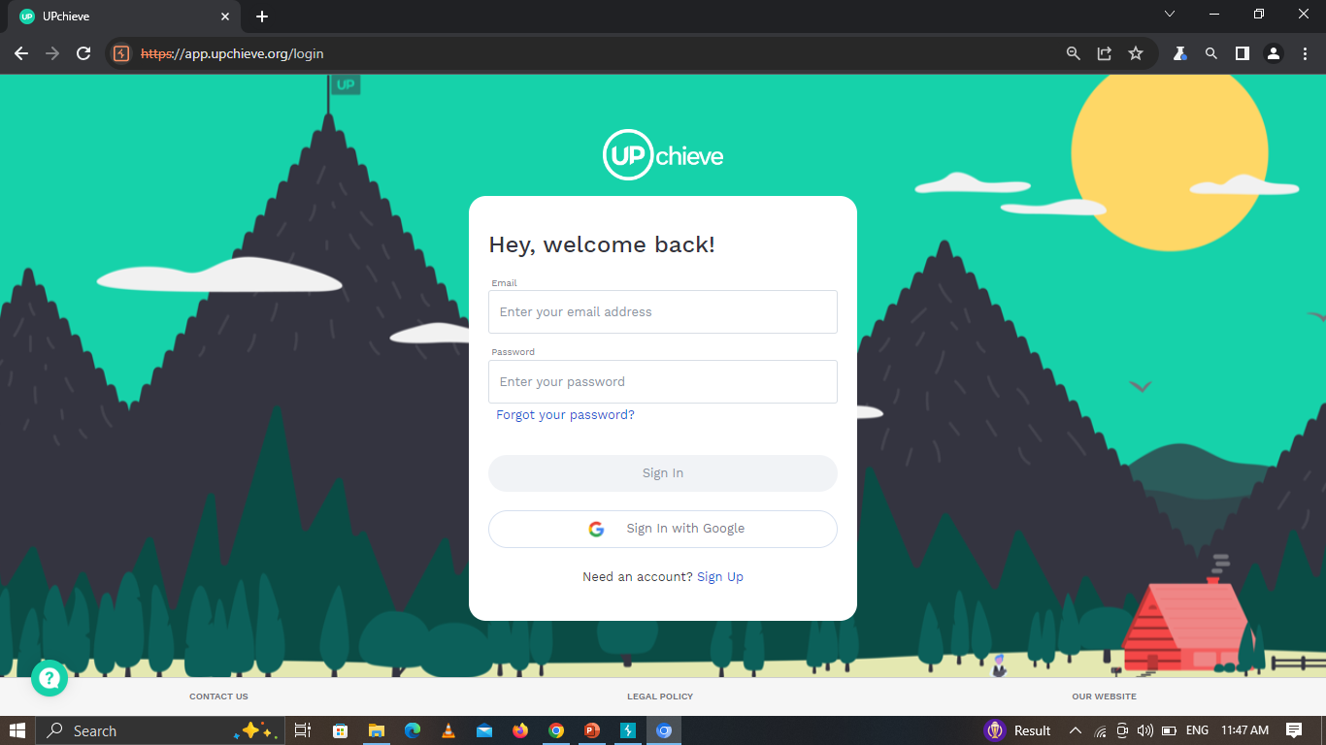
Step 1 :- Visit the website and click on sign up

Slide 64
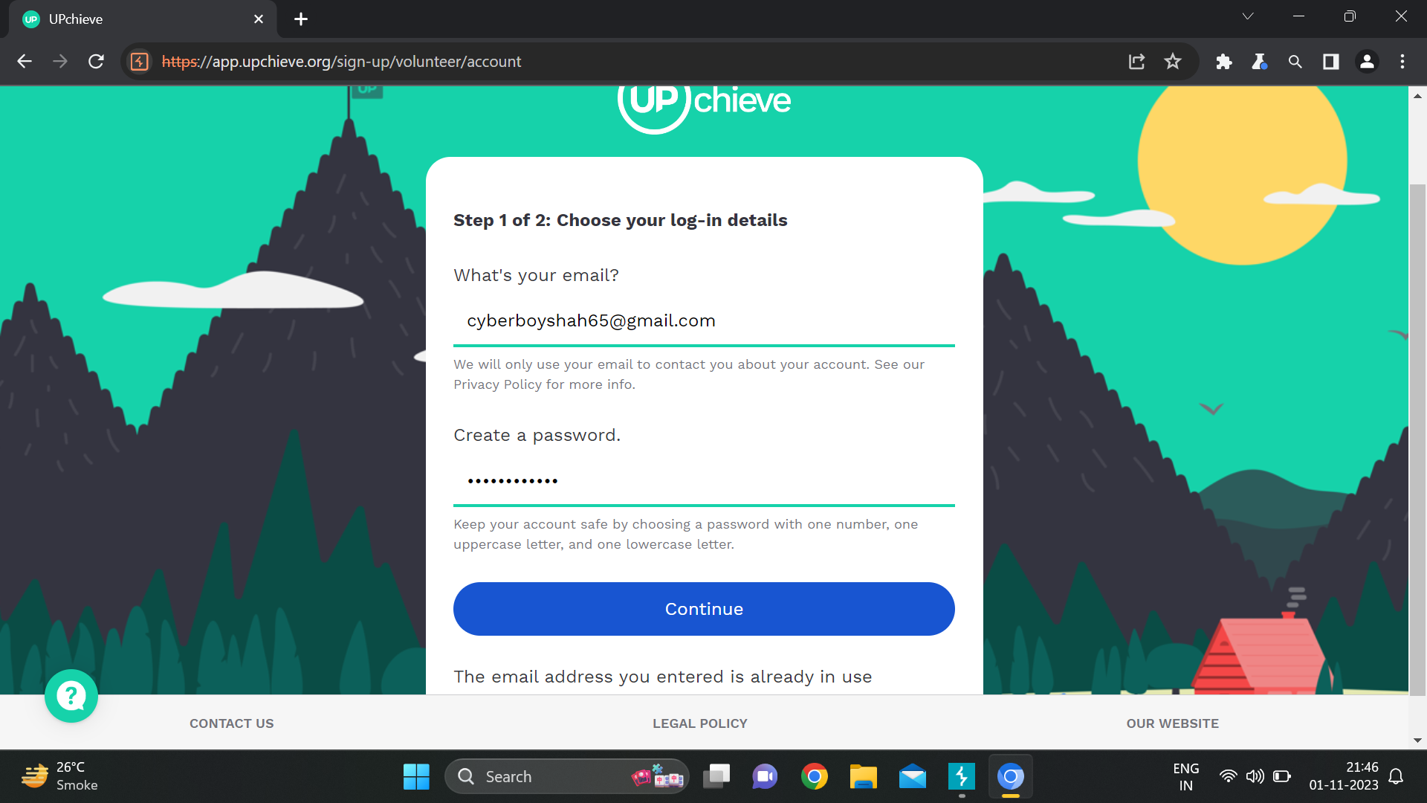
Step 2 :- Enter your email address and password and click to continue.

Slide 65
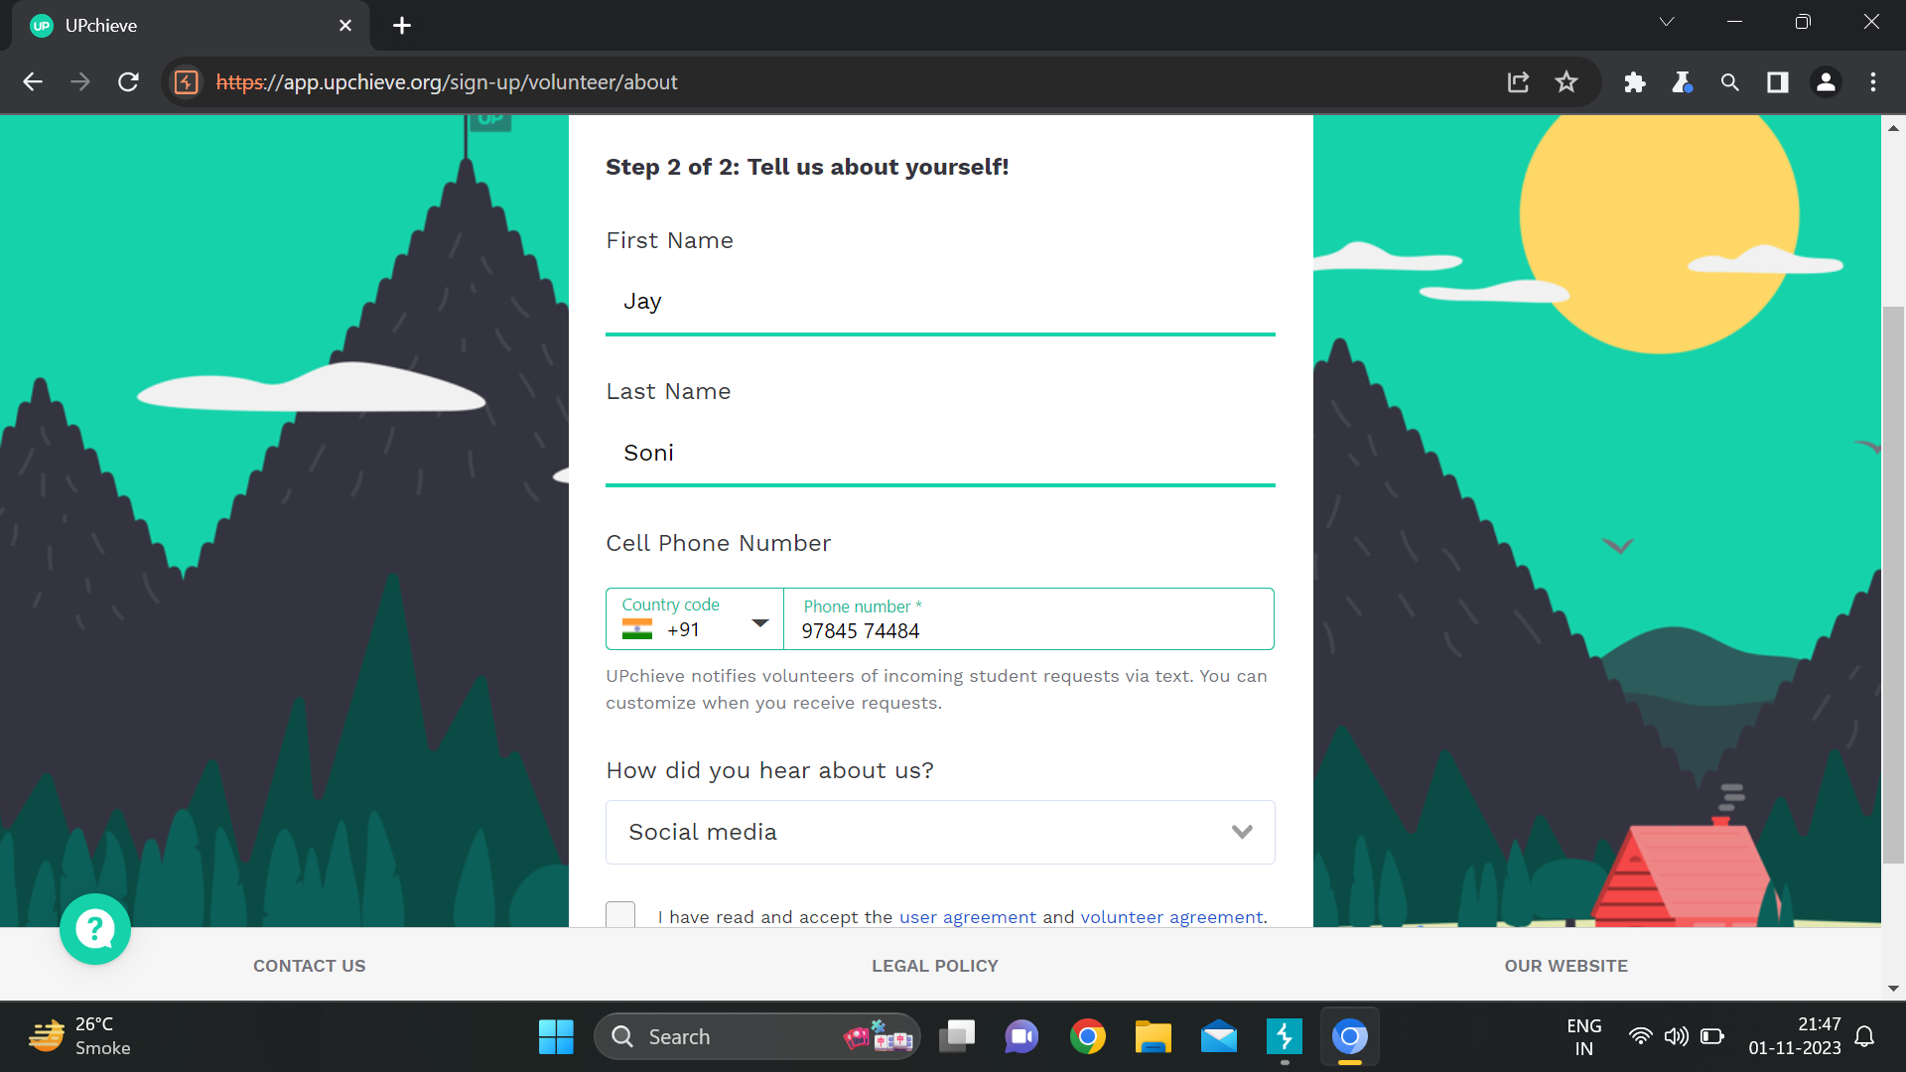
Step 3 :- Fill up your detail and click to sign up.

Slide 66
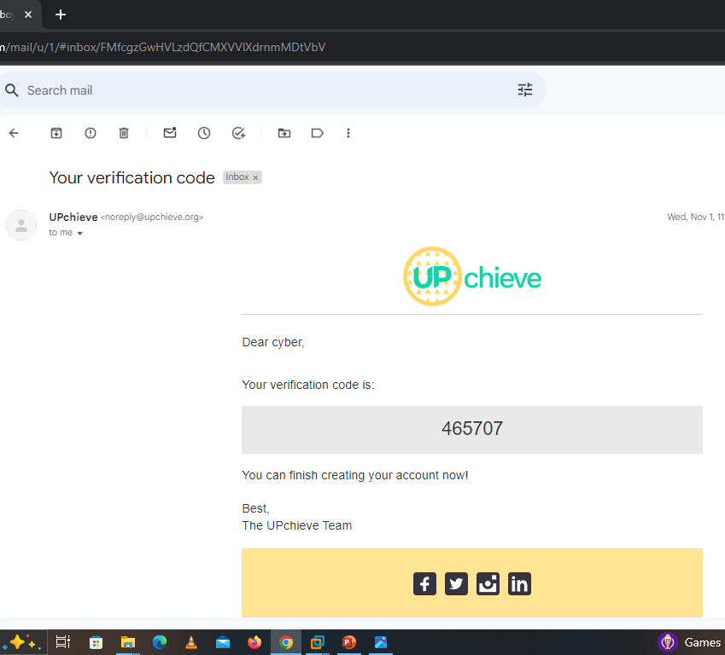
OTP from website

Slide 67
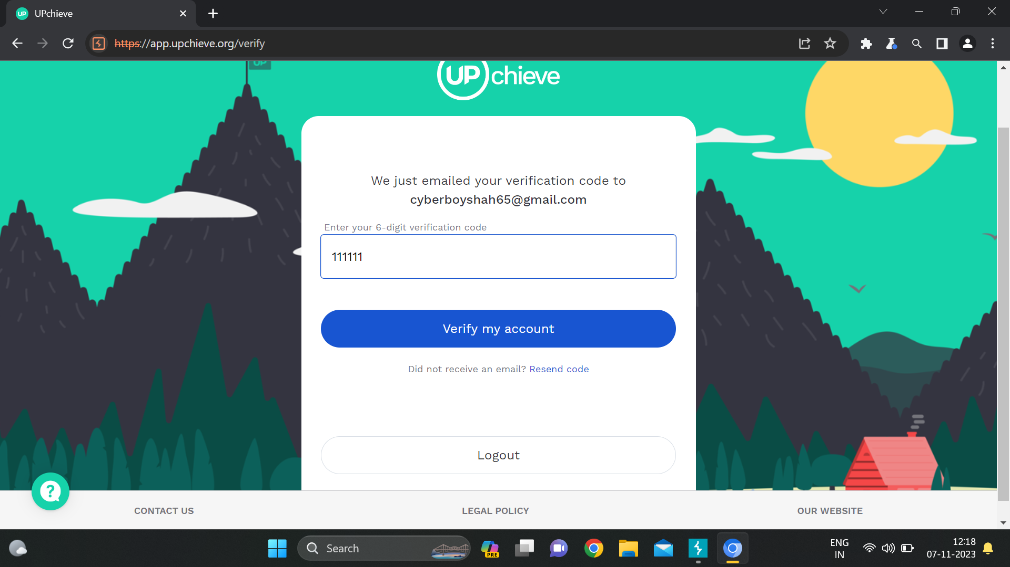
Step 4 :- Now OTP send to the email id, so enter any wrong OTP and click to verify
my account and capture the request through burp suite.

Slide 68
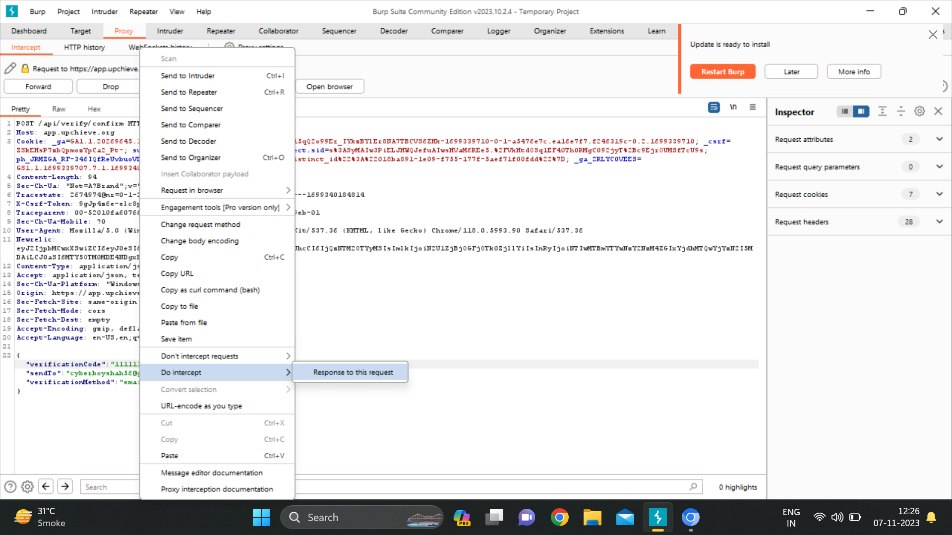
Step 5 :- After forwarding, Do intercept and send the Response to this Request.

Slide 69
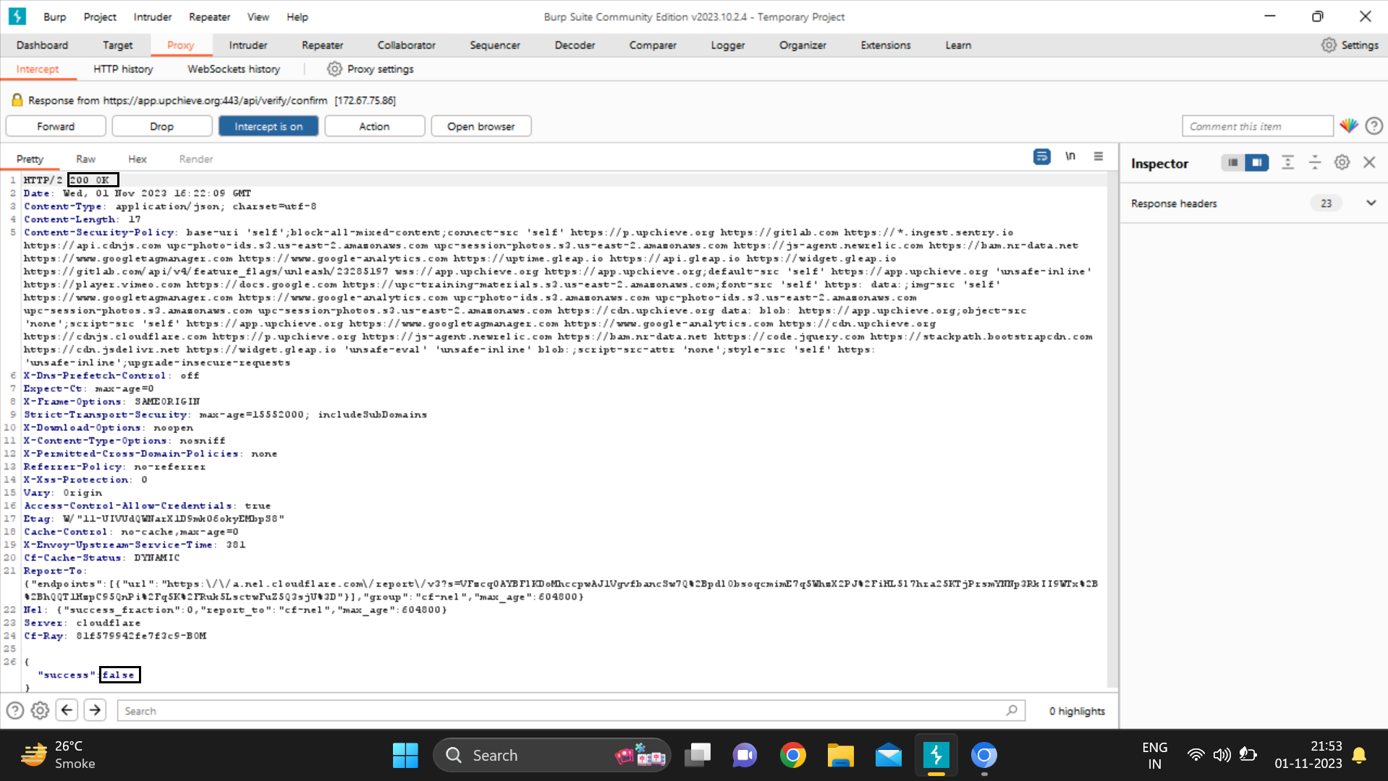
Step 6 :- Here we get the request response as “success:false”.

Slide 70
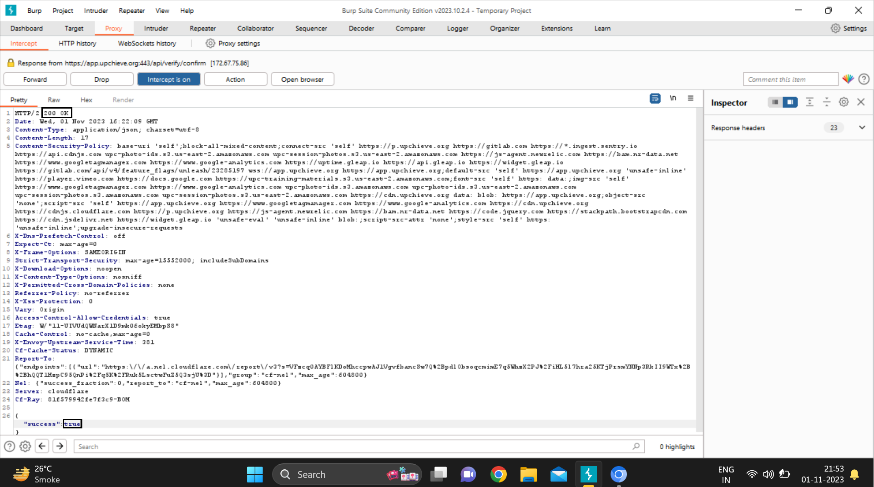
Step 7 :-Now change the code “Success” :False to “Success” :True and click to forward request.

Slide 71
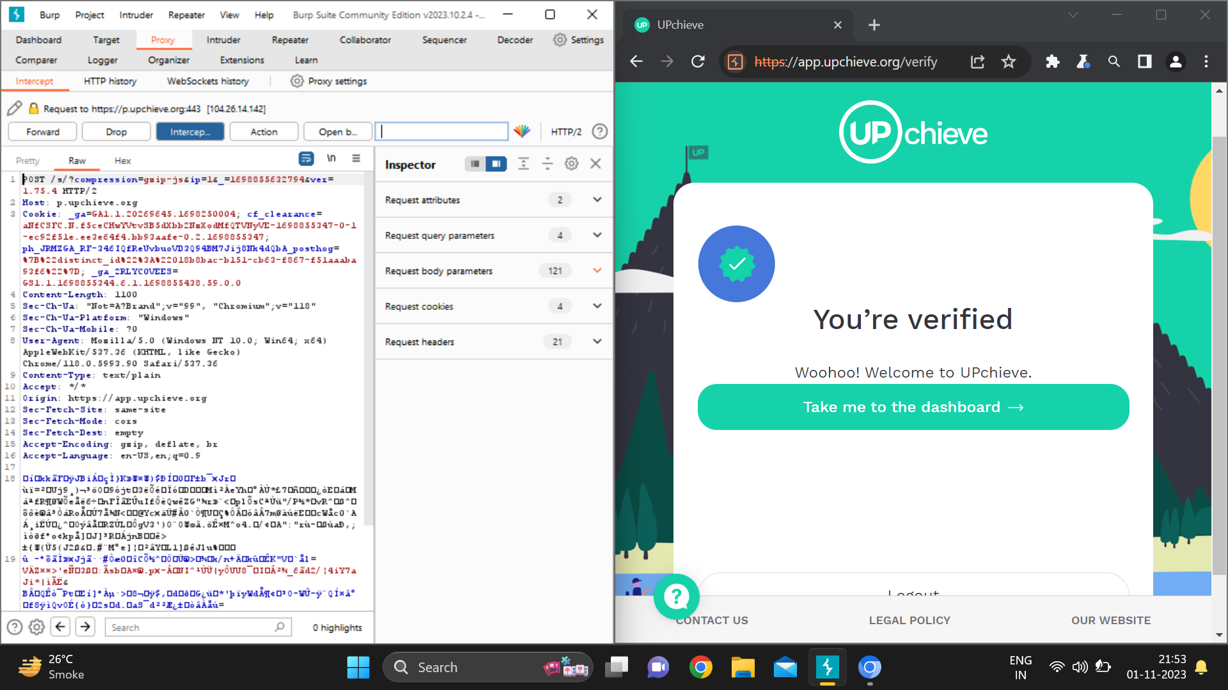
Step 8 :-As a result, we get the message You’re verified.So our account created successfully without entering OTP.

Slide 72
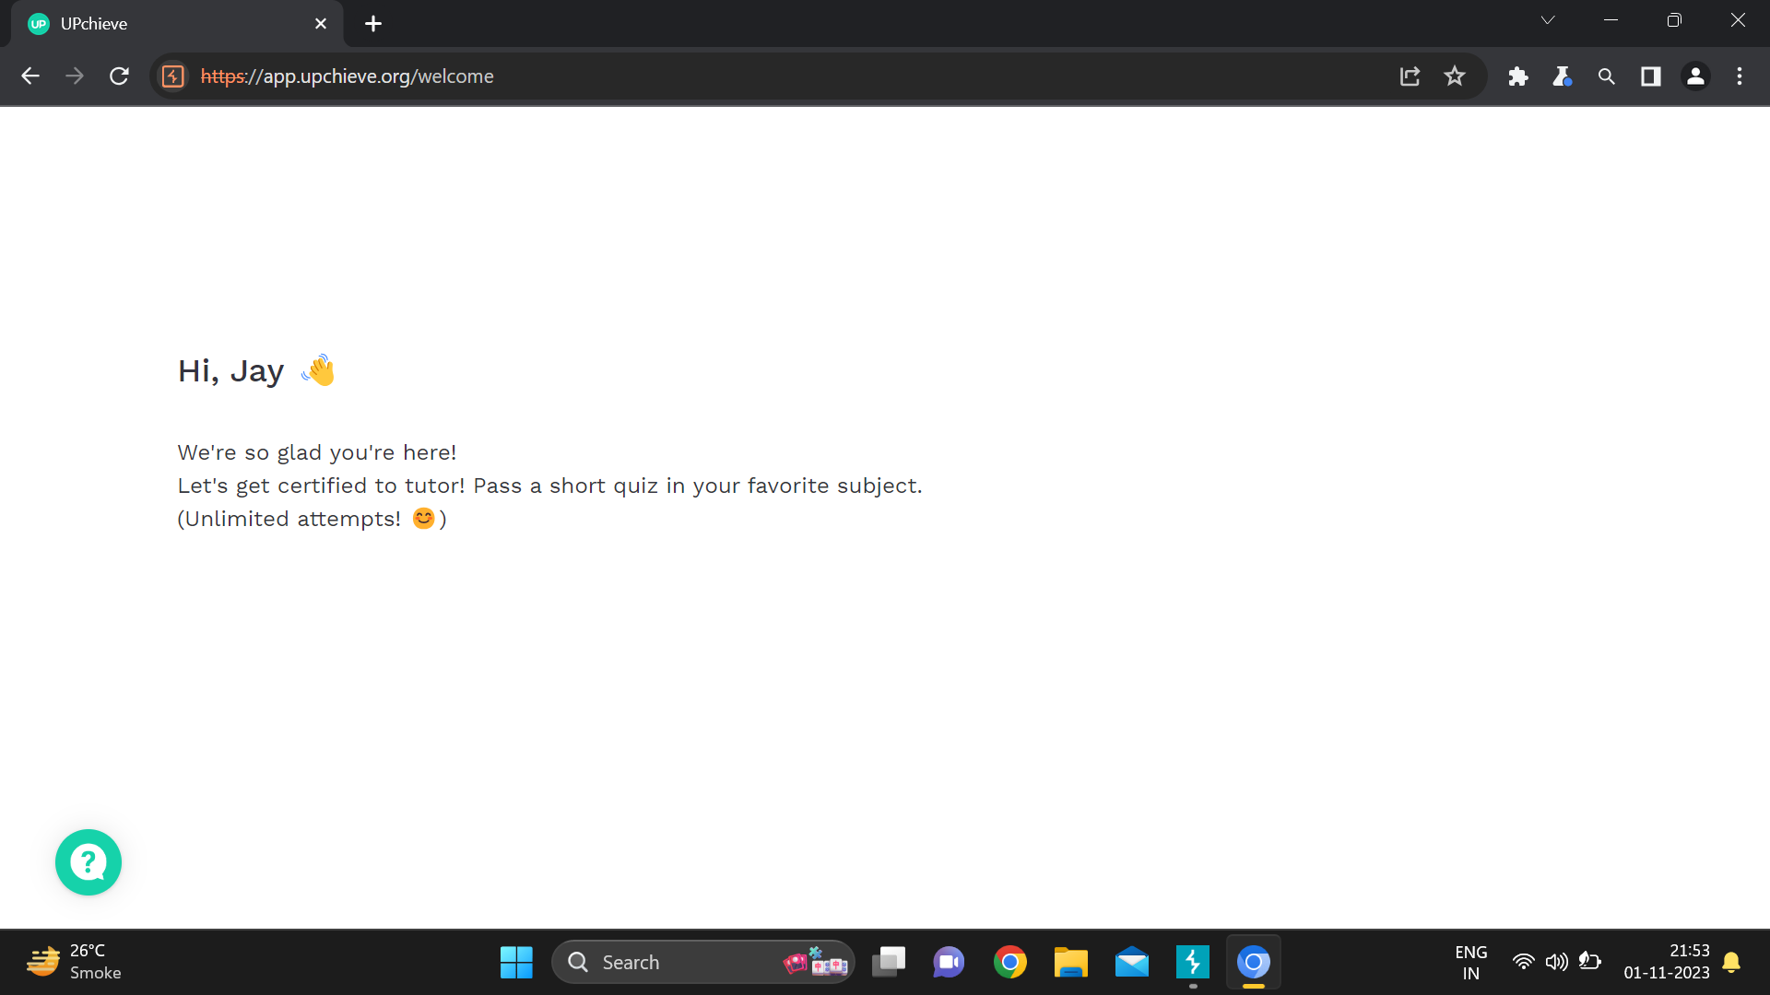

Slide 73
OTP Email Bypass Prevention
Use CAPTCHA
Use strong password
Limit Logins to a Specified IP Address
Use 2-Factor Authentication
Monitor Your Server Logs
Account Lockouts After Failed Attempt

Slide 74

8
Cross Site Scripting
Tools : PWnXss Scanner
Website: http://altoromutual.com/

Slide 75

Target Site
http://atloromutual.com/
Vulnerability
Cross Site Scripting (XSS)
Severity
High (https://bugcrowd.com/vulnerability-rating-taxonomy)
Impact
The attacker can hijack user accounts and steal the sensitive data. An attacker can also steal cookies and sessions.
Tools
PWnXss

Slide 76
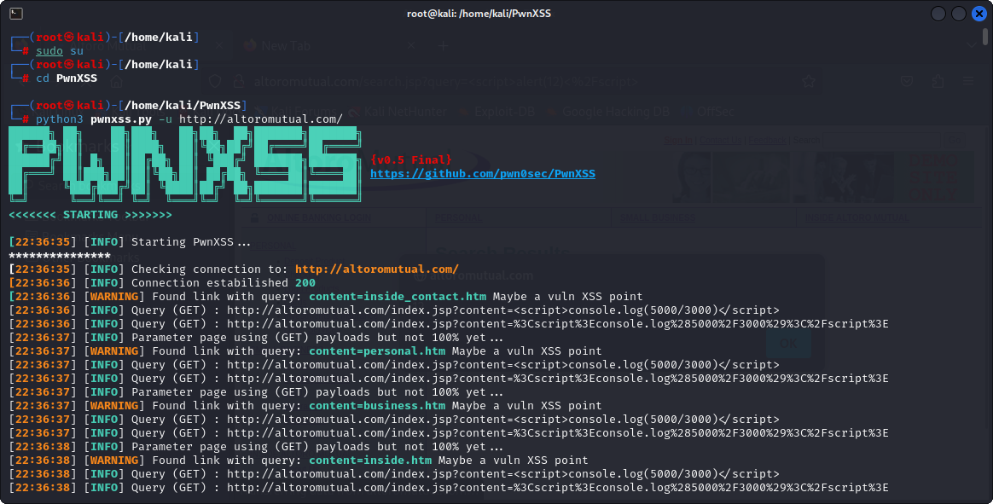
Step 1:- Run PWNXSS tools in kali with -u url and enter

Slide 77
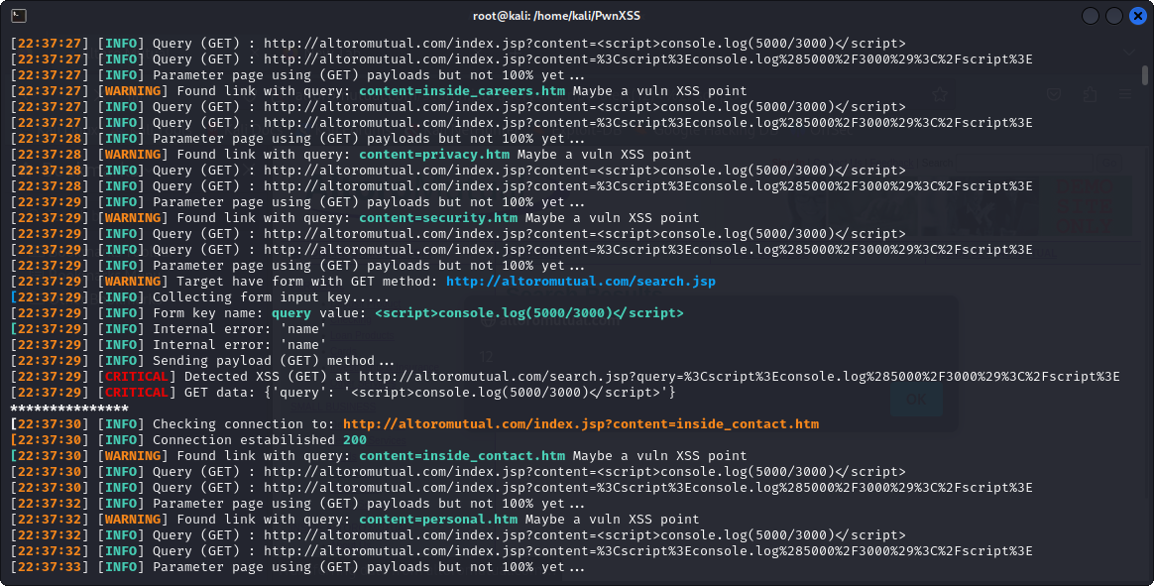
PWNXSS tool scan the website and show the result

Slide 78
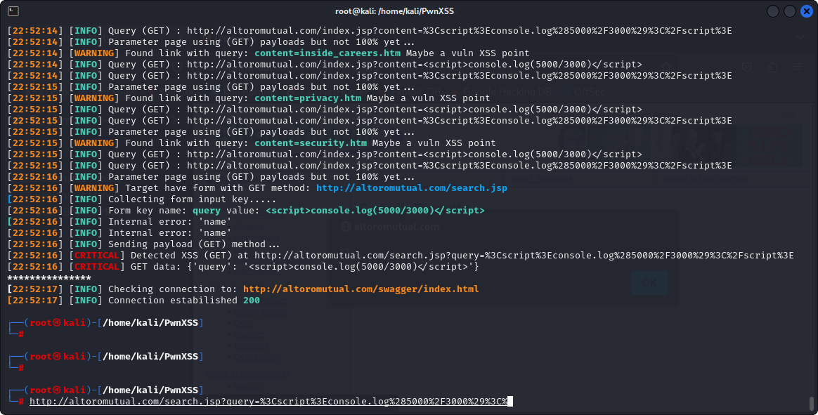

Slide 79
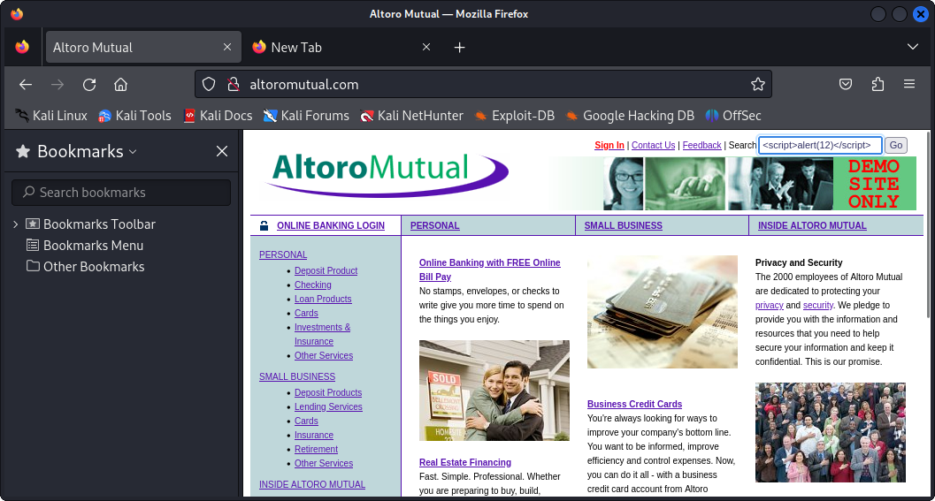
Step 2:-Now add the <script>alert(12)</script>in Search box and enter.

Slide 80
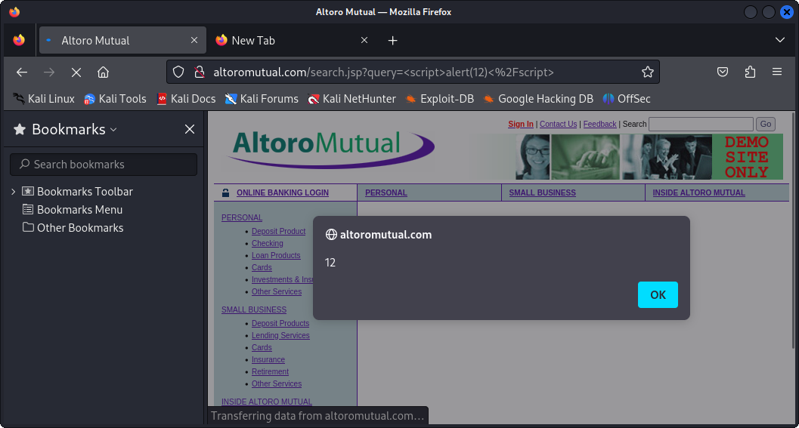
We see the alert message on the screen

Slide 81

Cross Site Scripting(XSS) Prevention
Avoid Inserting Untrusted Data Except in Allowed Locations like HTML Entity and HTML Attribute etc..
Output Encoding
Implement Input Validation
Use Security Headers

Slide 82

9
No Rate Password limit
Tools : Burp Suite
Website : https://app.salesflare.com/

Slide 83

Target Site
https://app.salesflare.com/
Vulnerability
No Rate Password Limit
Severity
High (https://bugcrowd.com/vulnerability-rating-taxonomy)
Impact
There is no rate limit enabled for the "Old Password" field on changing password on your website. A malicious minded user can continually try to brute force an account password.
Tools
Burp Suite

Slide 84

Step 1 :-Visit the Site

Slide 85

Step 2 :- Open login page.

Slide 86

Step 3 :-Click on Forgot your password and enter Email id and click in send.

Slide 87

Step 4 :-Here we get the single email for reset password link.

Slide 88

Step 5 :- Again,Go to forgot password page and enter email id and click on send with fetch the burp suite request. And send the request to intruder.

Slide 89

Step 6 :- After clear all $ and add the $ only 5 and go to the payload option.

Slide 90

Step 7 :- In this payload option select the payload type number and start and end number. After click on the start attack.

Slide 91

Step 8 :- The attack is start successfully.

Slide 92

Step 9 :-As a result,we get the 10 email in Gmail Account.

Slide 93



No Rate Password Limit Prevention
Extra precautions are taken with login, otp, vouchers etc.
Monitoring API activity against your rate limit.
Catching errors cause by rate limiting.
Reducing the number of requests.

Slide 94

10
SQL Injection
Tools :- SQLmap
Website:- https://www.atholbooks-sales.org/

Slide 95

Target Site
https://www.atholbooks-sales.org/
Vulnerability
SQL Injection
Severity
Critical (https://bugcrowd.com/vulnerability-rating-taxonomy)
Impact
The attacker can hijack user accounts and steal the sensitive data. An attacker can also steal cookies and sessions.
Tools
Sqlmap

Slide 96

Step 1 :- Visit the site: https://www.atholbooks-sales.org/

Slide 97

Step 2 :- Use SQL map tool in kali Linux. put -u before the URL and then provide the URL. Use --dbs for getting the database control and use –risk 1 for increasing the risk level then we get the information that the backend database is MySQL.

Slide 98

Here We get all the database name

Slide 99

Step 3:- After getting the database name use --tables command for retrieve all the tables name

Slide 100

Here We get all the Tables name from the Database

Slide 101

Step 4:- After getting the tables we have to find columns in that tables for that use -D database name -T table name – –columns.

Slide 102

Here the columns in that table will be retrieved.

Slide 103

Step 5:- After getting the column of that table use --dump for retrieve the data of that table.

Slide 104

Step 8:- As a result, we found the data of those table.

Slide 105


Slide 106


Slide 107


Slide 108
SQL Injection Prevention
Use Prepared
Statements
Allow-list Input
Validation
Continuous Scanning and Penetration Testing
Restrict Database Access

Slide 109
Future Scope
The future scope of VAPT is promising as cybersecurity continues to be a top priority. With evolving technologies, the demand for robust security measures will increase.
VAPT will play a crucial role in adapting to new threats, securing IoT devices, cloud environments, and emerging technologies like AI and blockchain. Continuous advancements in VAPT methodologies will be essential to stay ahead of evolving cyber threats.

Slide 110
References
https://portswigger.net/burp/communitydownload
https://owasp.org/www-project-top-ten/
https://www.google.com
https://github.com/pwn0sec/PwnXSS
https://www.atholbooks-sales.org/

Slide 111


